Slide 1
Competitive Networks
Instructor: Dr. Mohammad Rashedur Rahman

Slide 2
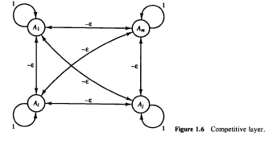
Introduction
When we applied a net that was trained to classify the input signal into one of the output categories, A, B, C, D, E, J, or K,
The net sometimes responded that the signal was both a C and a K, or both an E and a K, or both a J and a K.
In circumstances such as this, in which we know that only one of several neurons should respond, we can include additional structure in the network so that the net is forced to make a decision as to which one unit will respond. The mechanism by which this is achieved is called competition.
This type of neural network is known as competitive neural network.

Slide 3
Introduction (Cont..)
Winner Take All. As the name suggests, only one neuron in the competing group will have a nonzero output signal when the competition is completed. A specific competitive net that performs Winner-Take-All competition is the MAXNET.
MAXNET [Lippmann, 1987] is a specific example of a neural net based on competition. It can be used as a subnet to pick the node whose input is the largest.
The m nodes in this subnet are completely interconnected, with symmetric weights. There is no training algorithm for the MAXNET; the weights are fixed.

Slide 4
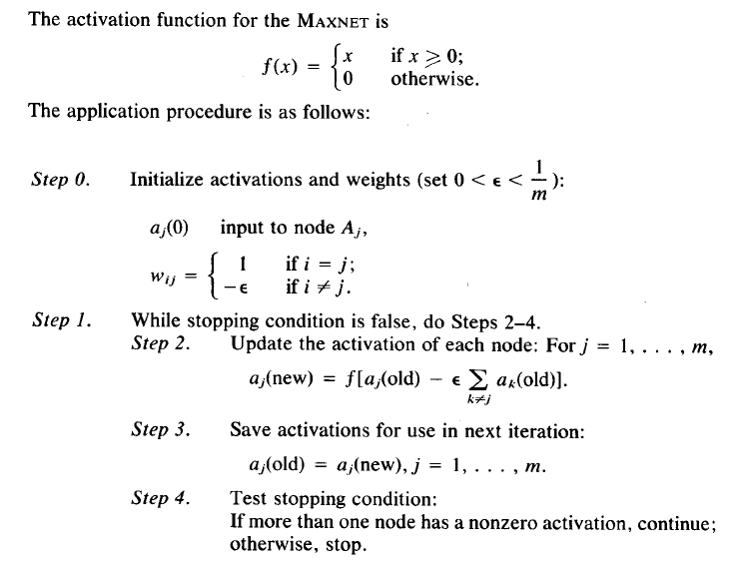
Algorithm

Slide 5
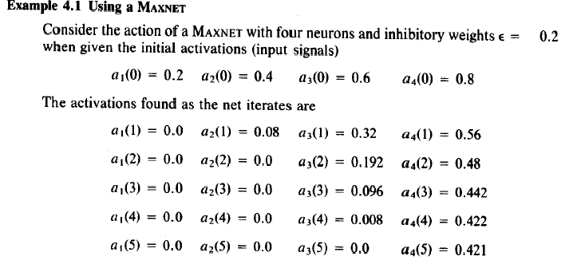
MAXNET Example

Slide 6
Hamming Network
A Hamming net [Lippmann, 1987; DARPA, 1988] is a maximum likelihood classifier net that can be used to determine which of several exemplar vectors is most similar to an input vector (an n-tuple).
The exemplar vectors determine the weights of the net.
The measure of similarity between the input vector and the stored exemplar vectors is n minus the Hamming distance between the vectors.

Slide 7
Hamming Network (Cont..)
The Hamming distance between two vectors is the number of components in which the vectors differ. For bipolar vectors x and y,
x-y = a - d,
where a is the number of components in which the vectors agree and d is the
number of components in which the vectors differ, i.e., the Hamming distance.
However, if n is the number of components in the vectors, then
d = n - a
and
x-y = 2a - n,
or
2a = x-y + n.

Slide 8
Hamming Network (Cont..)
By setting the weights to be one-half the exemplar vector and setting the value of the bias to n/2,
The net will find the unit with the closest exemplar simply by finding the unit with the largest net input.
The Hamming net uses MAXNET as a subnet to find the unit with the largest net input.

Slide 9
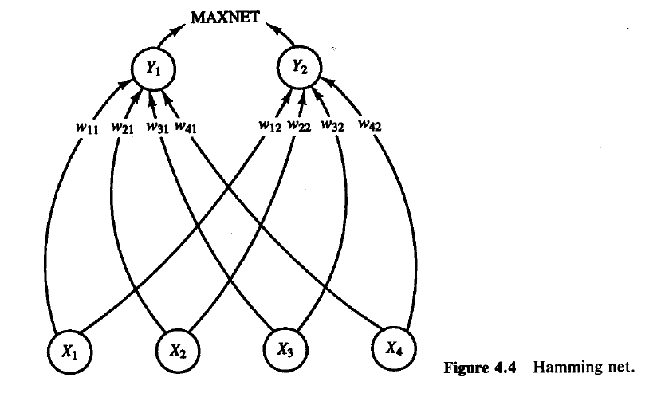
Hamming Network (Cont..)
The lower net consists of n input nodes, each connected to m output nodes (where m is the number of exemplar vectors stored in the net).
The output nodes of the lower net feed into an upper net (MAXNET) that calculates the best exemplar match to the input vector. The input and exemplar vectors are bipolar.
The sample architecture shown in Figure 4.4 assumes input vectors are 4-tuples, to be categorized as belonging to one of two classes.

Slide 10
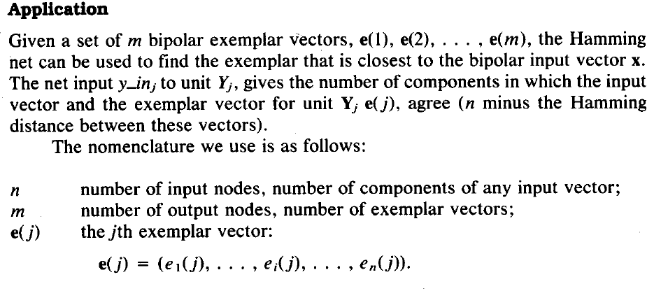
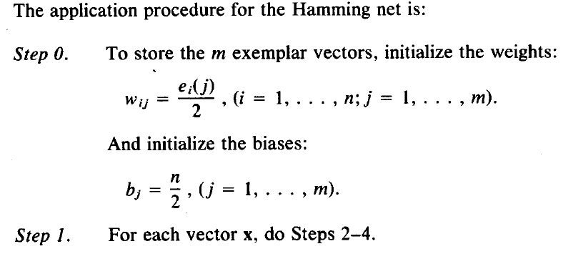
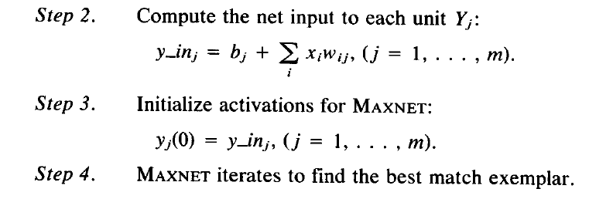
Hamming Network (Algorithm)

Slide 11
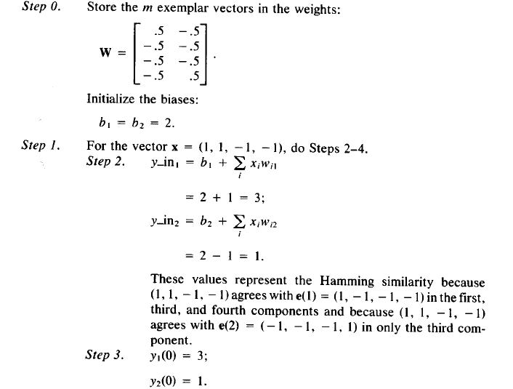
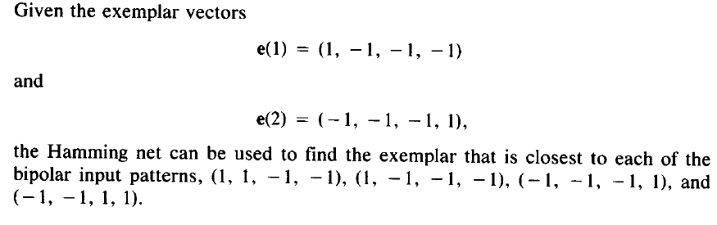
Hamming Network Example

Slide 12
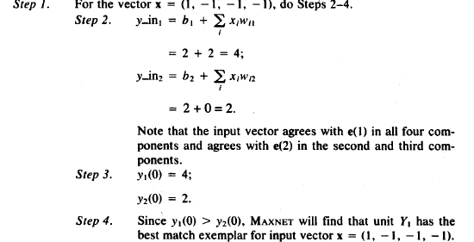
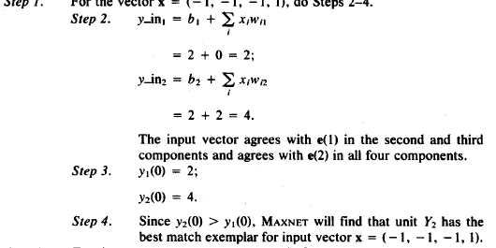
Hamming Network Example (Cont..)

Slide 13
Kohonen Self-Organizing Maps (SOM)
The self-organizing neural networks described in this section, also called topology-preserving maps, assume a topological structure among the cluster units.
This property is observed in the brain, but is not found in other artificial neural net-works.
There are m cluster units, arranged in a one- or two-dimensional array; the input signals are n-tuples [Kohonen, l989a].
The weight vector for a cluster unit serves as an exemplar of the input patterns associated with that cluster.
During the self-organization process, the cluster unit whose weight vector matches the input pattern most closely (typically, the square of the minimum Euclidean distance) is chosen as the winner.

Slide 14
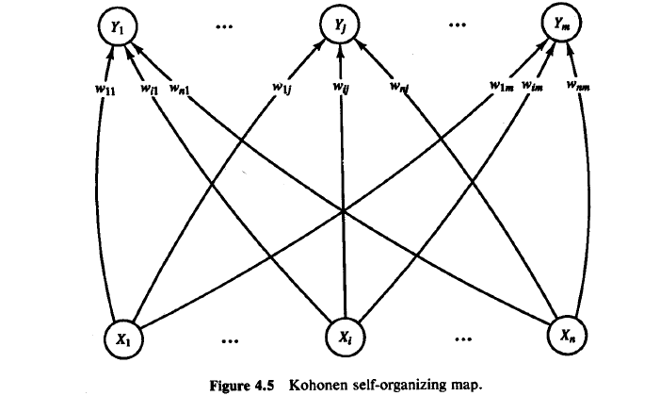
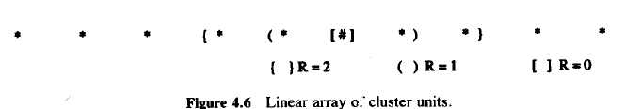
SOM (Cont…)
The winning unit and its neighboring units (in terms of the topology of the cluster units) update their weights. The weight vectors of neighboring units are not in general, close to the input pattern.
For example, for a linear array of cluster units, the neighborhood of radius R around cluster unit J consists of all units j such that
max(1, J - R) <=j <= min(J + R, m).
Here m is number of clusters
The architecture of the Kohonen self-organizing map is shown in Figure 4.5. Neighborhoods of the unit designated by # of radii R = 2, l, and 0 in a one-dimensional topology (with 10 cluster units) are shown in Figure 4.6.

Slide 15
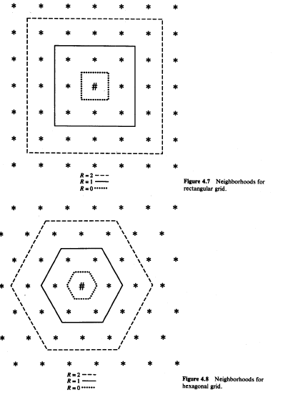
SOM (Cont…)
The neighborhoods of radii R = 2, 1 and 0 are shown in Figure 4.7 for a rectangular grid and in Figure 4.8 for a hexagonal grid (each with 49 units).
In each illustration, the winning unit is indicated by the symbol “#” and the other units are denoted by
Note that each unit has eight nearest neighbors in the rectangular grid, but only six in the hexagonal grid.
Winning units that are close to the edge of the grid will have some neighborhoods that have fewer units than that shown in the respective figure.
Neighborhoods do not “wrap around” from one side of the grid to the other; “missing” units are simply ignored.

Slide 16
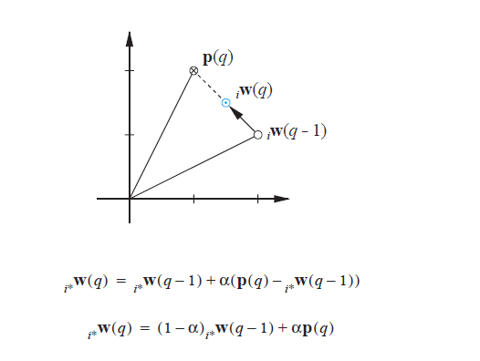
Graphical Representation

Slide 17
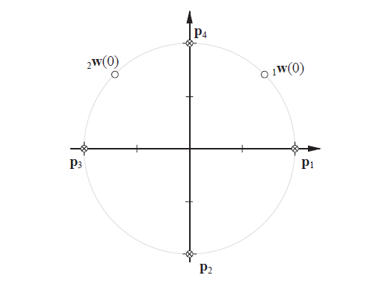
Graphical Representation (Cont..)

Slide 18
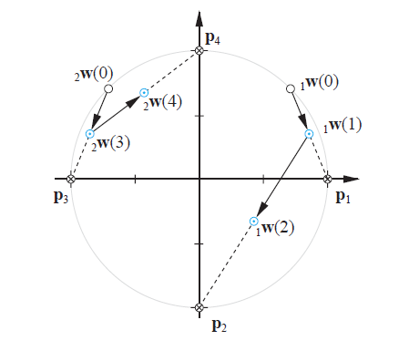
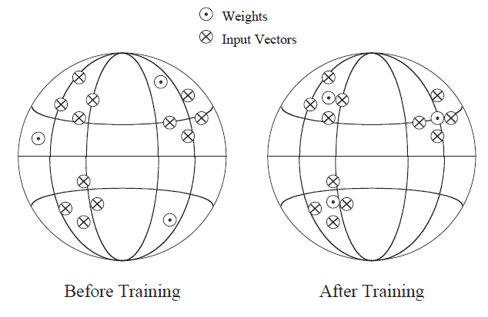
Graphical Representation (Cont..)

Slide 19

Algorithm: SOM

Slide 20
Choice of Radius and Learning Rate in SOM
The learning rate a is a slowly decreasing function of time (or training epochs). Kohonen (1989a, p. 133) indicates that a linearly decreasing function is satisfactory for practical computations; a geometric decrease would produce similar results.
The radius of the neighborhood around a cluster unit also decreases as the clustering process progresses.
The formation of a map occurs in two phases: the initial formation of the correct order and the final convergence.
The second phase takes much longer than the first and requires a small value for the learning rate. Many iterations through the training set may be necessary, at least in some applications [Kohonen,1989a].
Random values may be assigned for the initial weights.
If some information is available concerning the distribution of clusters that might be appropriate for a particular problem, the initial weights can be taken to reflect that prior knowledge. the weights are initialized to random values (chosen from the same range of values as the components of the input vectors).

Slide 21
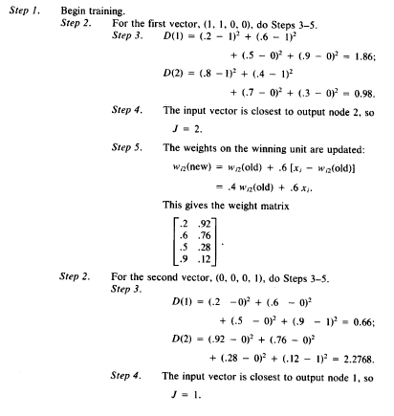
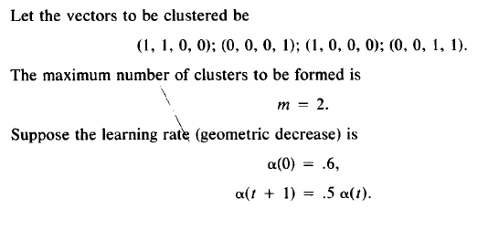
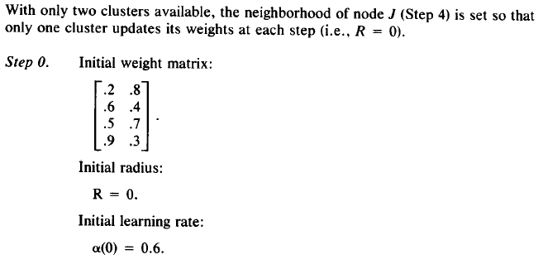
Example on SOM

Slide 22
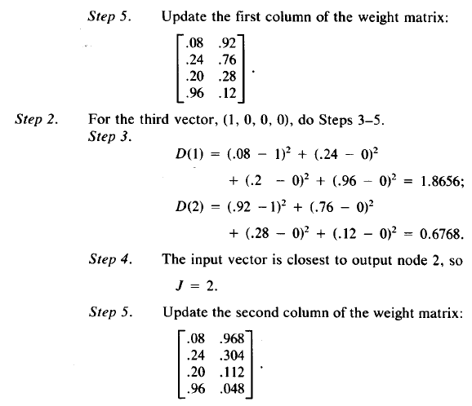
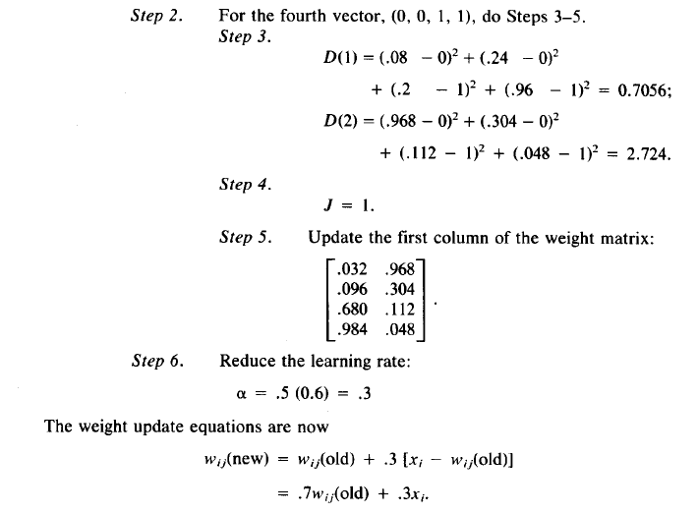
Example on SOM (Cont..)

Slide 23
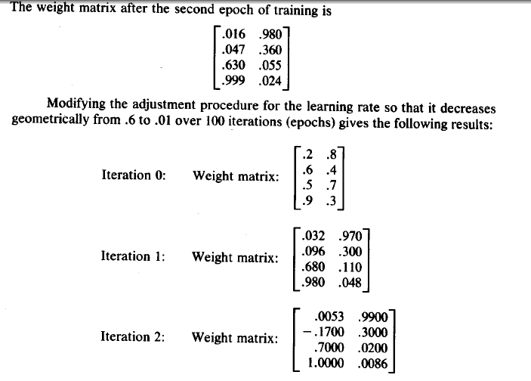
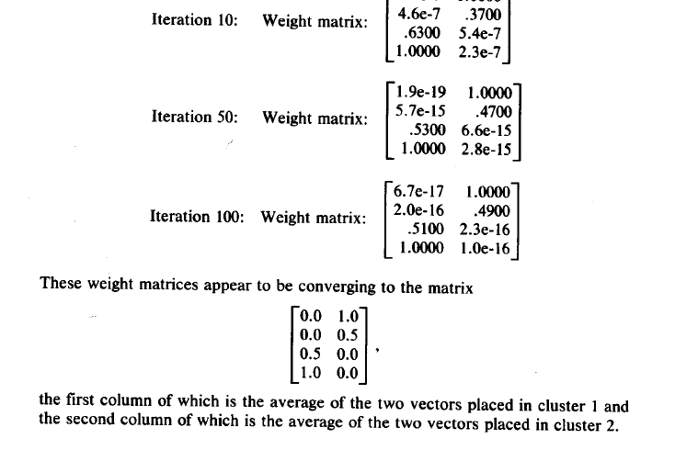
Example on SOM (Cont..)
(1,1,0,0) and (1,0,0,0) will be grouped together and (0,0,0,1) and (0,0,1,1) will be grouped together

Slide 24
LEARNING VECTOR QUANTIZATION (LVQ)
Learning vector quantization (LVQ) [Kohonen l989a, l990a] is a pattern classification method in which each output unit represents a particular class or category. (Several output units should be used for each class.)
The weight vector for an output unit is often referred to as a reference (or codebook) vector for the class that the unit represents. During training, the output units are positioned (by adjusting their weights through supervised training).
It is assumed that a set of training patterns with known classifications is provided, along with an initial distribution of reference vectors (each of which represents a known classification).
After training, an LVQ net classifies an input vector by assigning it to the same class as the output unit that has its weight vector (reference vector) closest to the input vector.

Slide 25
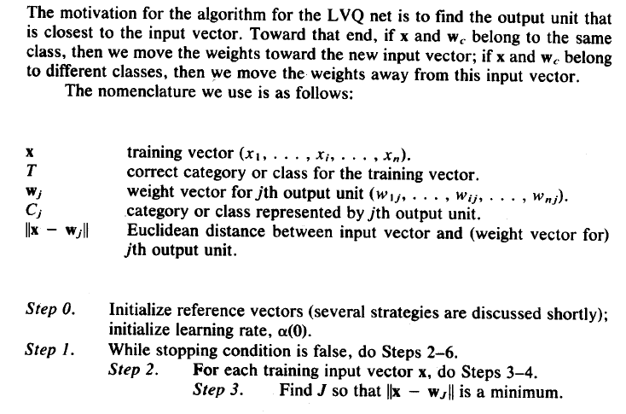
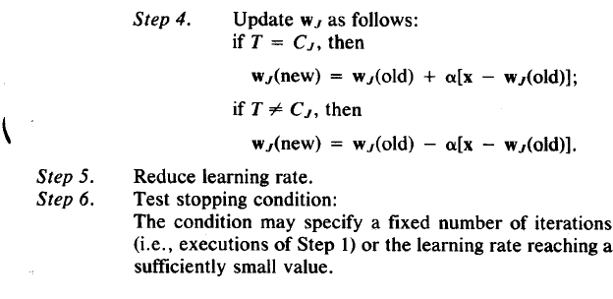
LVQ Algorithm (Cont..)

Slide 26
LVQ Weight Initialization
The simplest method of initializing the weight (reference) vectors is to take the first m training vectors and use them as weight vectors, the remaining vectors are then used for training.
Another possible method for initializing the weights is to use k-means clustering or the self organizing maps to place the weights.
Each weight vector is then calibrated by determining the input patterns that are closest to it, finding the class that the largest number of these input patterns belong to and assigning that class to the weight vector.

Slide 27
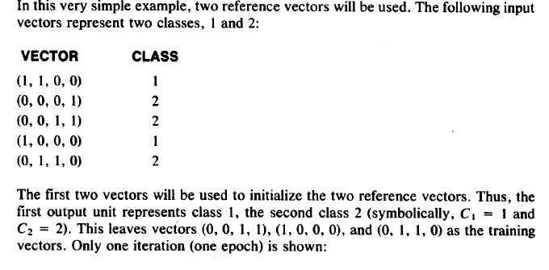
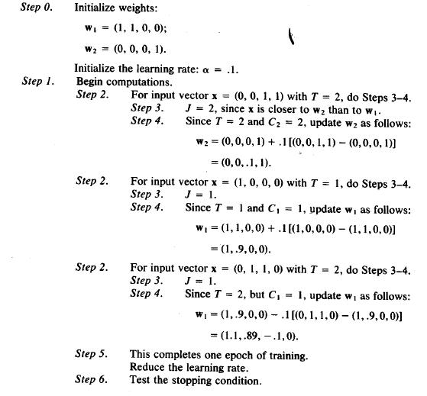
LVQ Example

Slide 28
LVQ2
In the original LVQ only the reference vector that is close to the input vector is updated.
The direction it is moved depends on whether the winning reference vector belongs to the same class as the input vector.
In the improved algorithm like LVQ2 two vectors (a winner and a runner-up) learn if several conditions are satisfied.
The idea is that if the input is approximately the same distance from both the winner and the runner-up then each of them should learn.

Slide 29
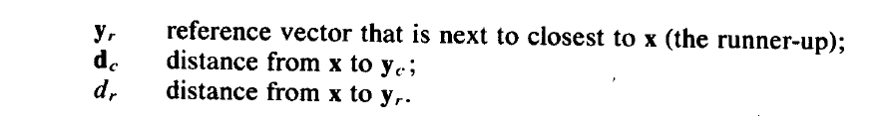
LVQ2 (Cont..)

Slide 30
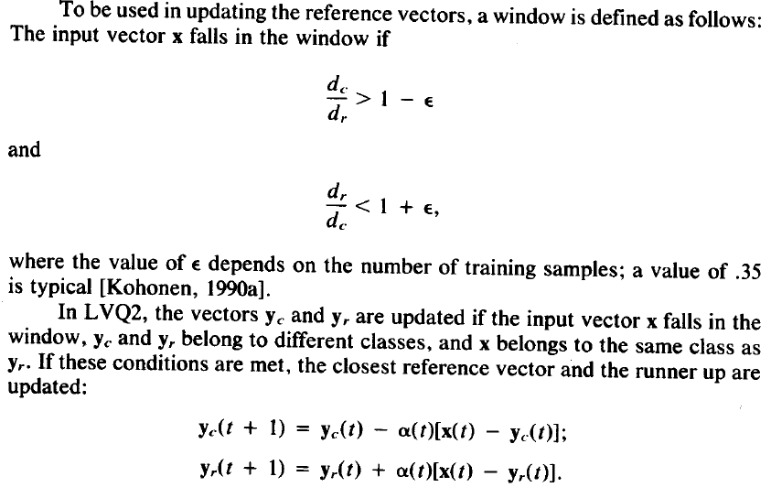
LVQ 2 (Cont..)

